Slide 1
Development of Assessment tool for vital body parameters measurement
Presented By
Ankita Khadatkar 105
Rohan Mundhey 149
Tejas Sagane 160
Wasuraj R. Kannao 165
Under the Guidance of
Prof. Minal Keote

Slide 2
Contents
Introduction
Problem Statement
Literature Survey
Working
References

Slide 3
Introduction
Development of Assessment tool for vital body parameters measurements.
To collect Vital Body Parameters with the help of sensors & take Decision based on Data.
To continuously monitor health of a person by health parameters like Temperature, ECG, Heartbeat and blood pressure & take intelligent decision based on collected data & also to reduce overall cost on Medicare system.
The requirement in the health care field is rising rapidly, and therefore we need a well-equipped efficient monitoring system for health care centres.

Slide 4
Problem statement
To continuously monitor health of a person & take intelligent decision based on collected data & also to reduce overall cost on Medicare system

Slide 5
LITERATURE SURVEY
The proposed device has sensors incorporated together to monitor vital signs of human body such as:
1.Heart rate
2.Oxygen level
3.Temperature
4.Blood pressure
5.Body weight for BMI.
There has been exponential increase in health care cost in the last decade. Patients have to make frequent visit to the doctors to get their vital signs measured. And every time they visit they have to keep their previous records with themselves. Now a day every age group has to go for a routine checkup and keep the records with themselves. So there is a need of device that can keep the record of every patient.

Slide 6
However this proposed device is basically designed for the rural areas where networks are not available and the people are not technically very sound. This proposed device is designed for doctor, the nurses and patients all so that anybody can measure the records and keep the records in pc and device itself. There are many portable devices in market that can measure the single body parameter and keep the records but there is lack of device that can measure all the body parameters together and keep records.
This proposed system represents a design and implementation of a reliable, cheap, low powered non-intrusive and accurate system that can measure many parameters of human body and keep the records of each patient. It gives an idea to make a database of each patient so that whenever the patient comes to the doctor he doesn’t have to keep his record with him manually.

Slide 7
Such a device can be handled by non technical personnel also and can be used both in small clinics and big hospitals. This system is presented with a motto of saving time of both the doctor and patients. As the device can measure the vital signs in a very less time it can save time of doctor and no. of patients can be observed.
This system specifically deals with the signal conditioning and data acquisition of three vital signs: heart rate, body temperature, and weight.The heart rate is measured by Heart beat sensor which works on the principle of light modulation by blood flow through finger at each pulse.To measure the oxygen amount in blood we use pulse oximeter. The pulse oximeter measures the ratio of red to infrared pulsating absorption, which is directly proportional to the oxygen saturation. The temperature is measured by using LM34 which measures the temperature directly in Fahrenheit and does not need external calibrations.

Slide 8
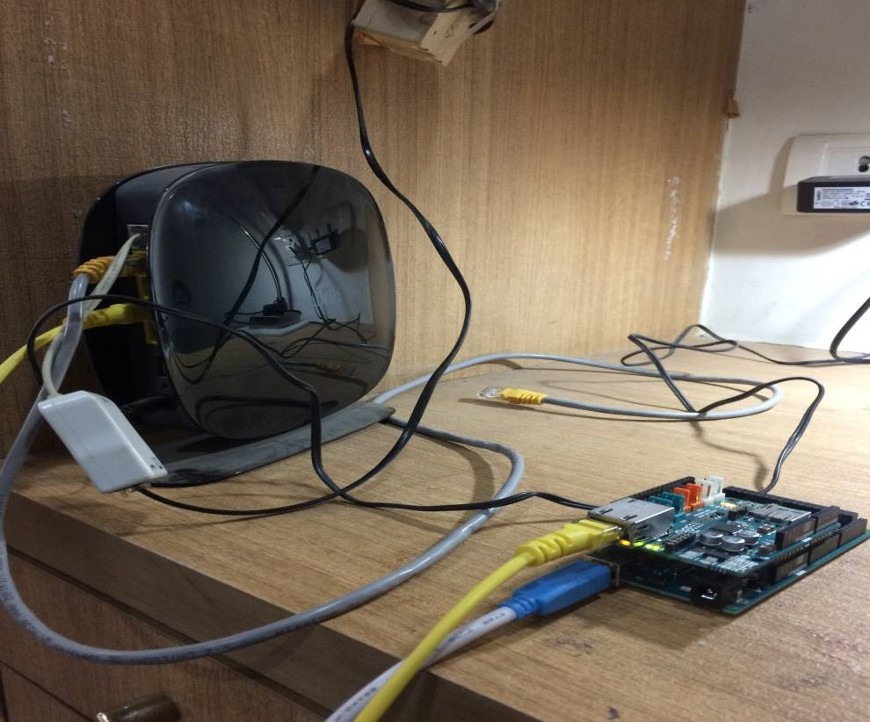
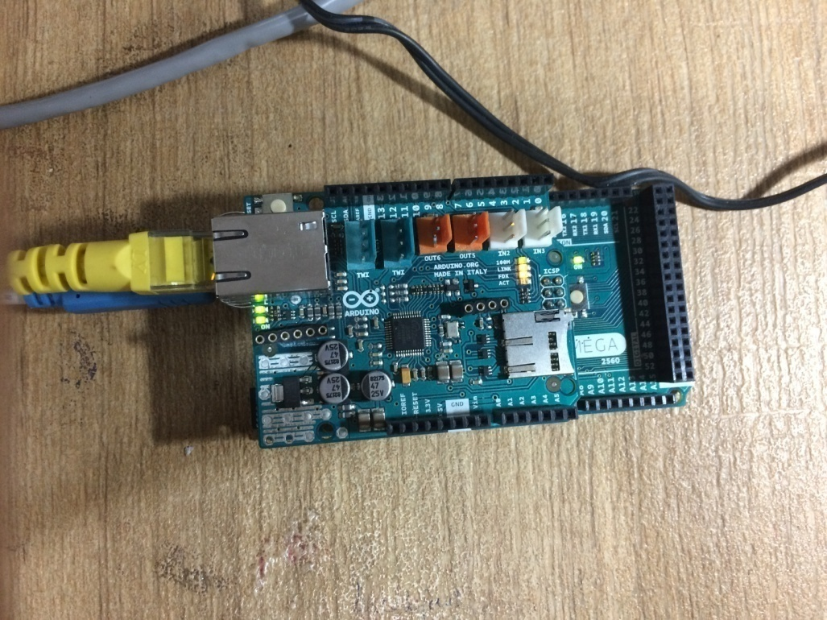
WORKING

Slide 9
BLOCK DIAGRAM
Arduino mega
Ethernet shield
Router
Temboo,Twilio(libraries)
User interface device

Slide 10
COMPONENT DETAILS
Arduino Mega
The Arduino Mega is a microcontroller board based on the ATmega1280 .
It has 54 digital input/output pins, 16 analog inputs, 4 UARTs (hardware serial ports), a 16 MHz crystal oscillator, a USB connection, a power jack, an ICSP header, and a reset button.
It contains everything needed to support the microcontroller; simply connect it to a computer with a USB cable or power it with a AC-to-DC adapter or battery to get started.
The Arduino Mega can be powered via the USB connection or with an external power supply. The power source is selected automatically.
The Arduino Mega can be programmed with the Arduino software
The ATmega2560 on the Mega 2560 comes preprogrammed with a bootloader that allows you to upload new code to it without the use of an external hardware programmer.

Slide 11
Ethernet Shield
The Arduino Ethernet Shield connects your Arduino to the internet in mere minutes.
Just plug this module onto Arduino board, connect it to network with an RJ45 cable.
The ethernet shield connects to an Arduino board using long wire-wrap headers which extend through the shield. This keeps the pin layout intact and allows another shield to be stacked on top.
With the Arduino Ethernet Shield, this library allows an Arduino board to connect to the internet. It can serve as either a server accepting incoming connections or a client making outgoing ones.
The library supports up to four concurrent connection (incoming or outgoing or a combination).

Slide 12
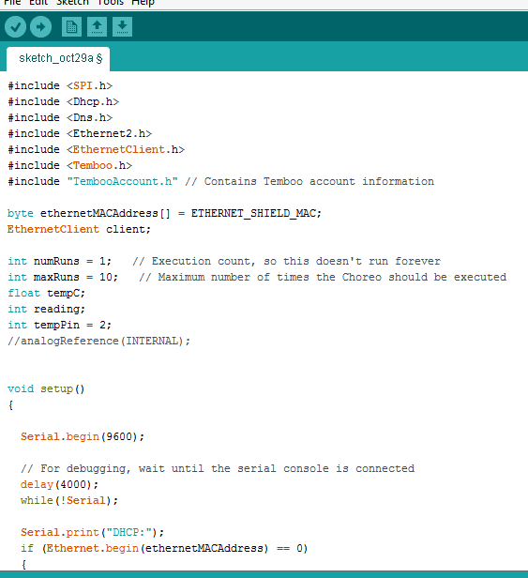
PROGRAM

Slide 13
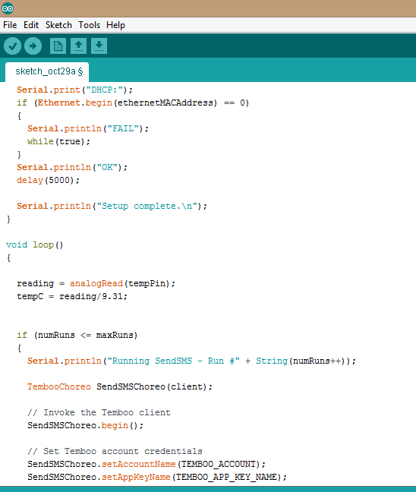

Slide 14
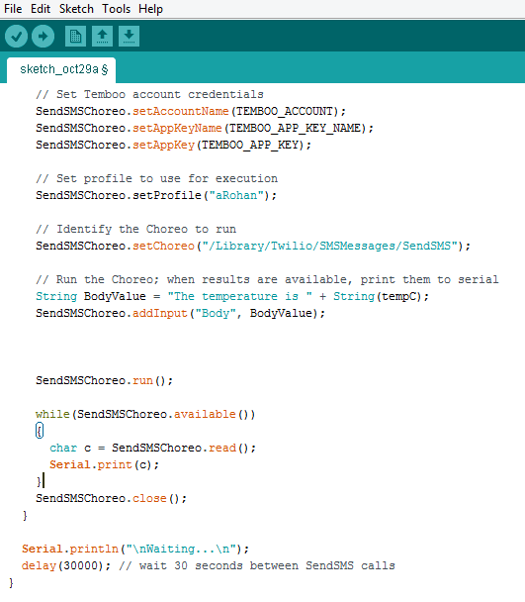

Slide 15
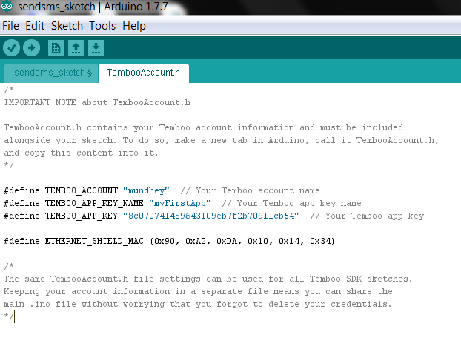

Slide 16
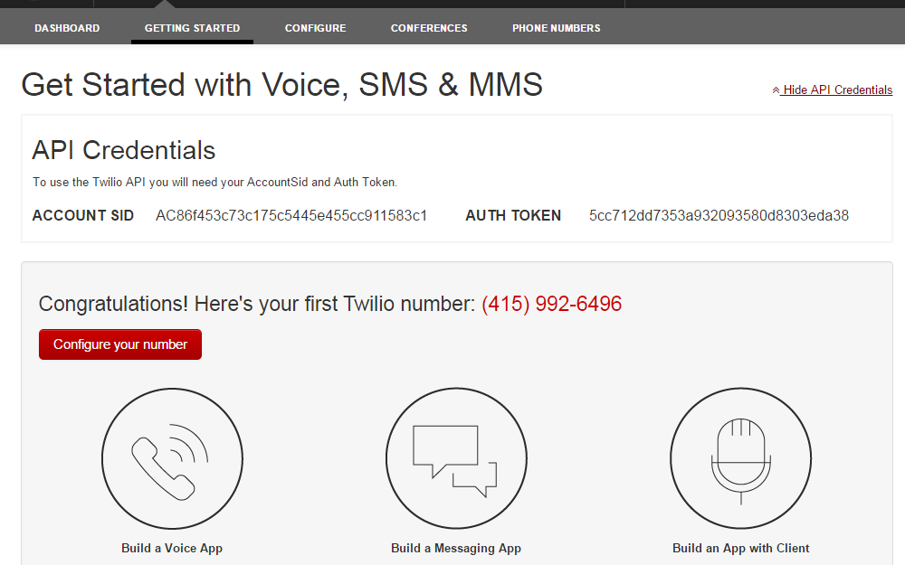

Slide 17
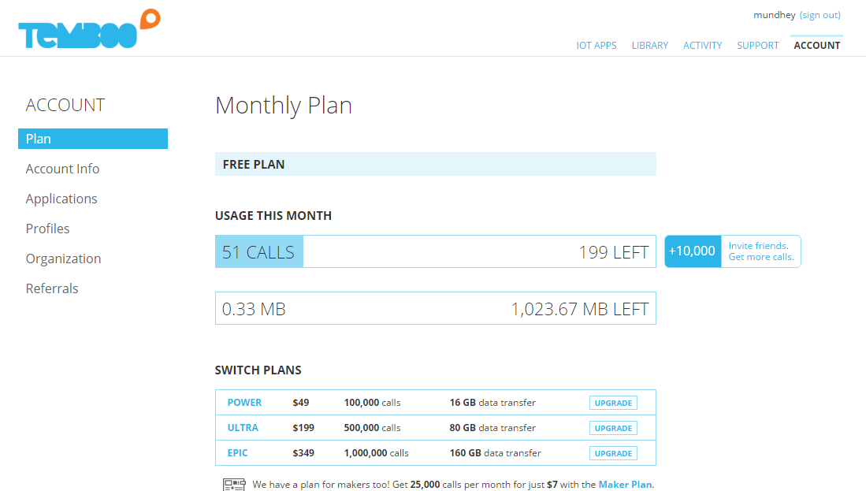

Slide 18
References
R. M. Potdar, “Advancement of Low-cost Medicare System for the Measurement of Physiological Parameters of Human Body”, International Journal of Engineering and Advanced Technology (IJEAT) ISSN: 2249 – 8958, Volume-1, Issue-6, August 2012
S.Tamilselvan,“A MICROCHIP WIRELESS BASED WEARABLE PHYSIOLOGICAL PARAMETERS MONITORINGSYSTEM”, International Journal of Latest Research in Science and Technology ISSN (Online):2278-5299 Volume 2,Issue 2 :Page No.71-74 , March - April (2013)
https://www.arduino.cc/
http://www.tcs.com/resources/white_papers/Pages/Connected-Health-Solutions.aspx
https://www.youtube.com/watch?v=QDo1xNA1UOg
https://www.google.com/patents/US5967975
https://www.youtube.com/watch?v=vcOE2XAQHzY
https://www.youtube.com/watch?v=XrjgFdHH4AI
https://www.twilio.com/api
https://temboo.com/library/

Slide 19
THANK YOU

